Slide 1

CSE-5325-005-SFWR ENG II: MGMT, MAIN, & QA
Online LMS
Team Members
Jaydeep Mojidra
Pranjal Kamboj
Samyak Jain
Dhruv Shah

Slide 2
Agenda
PROJECT SUMMARY
SDLC MODEL
WBS
DESIGN
TOOLS AND FRAMEWORK
RESOURCE ALLOCATION
GANTT CHART
COST ESTIMATION
ER DIAGRAM
API USED IN THE PROJECT
USER INTERFACE SNAPS
TESTING RESULTS
MANAGEMENT TOOL
FUTURE SCOPE
REFERENCES

Slide 3
Project Summary
We are developing a comprehensive basketball website offering website links to purchase ticket
A user-friendly sign-in page, quick access to team links, detailed information on upcoming events, matches, the latest news, and statistics on top scorers.
Additionally, users can personalize their experience with light-dark UI themes for optimal viewing.

Slide 4
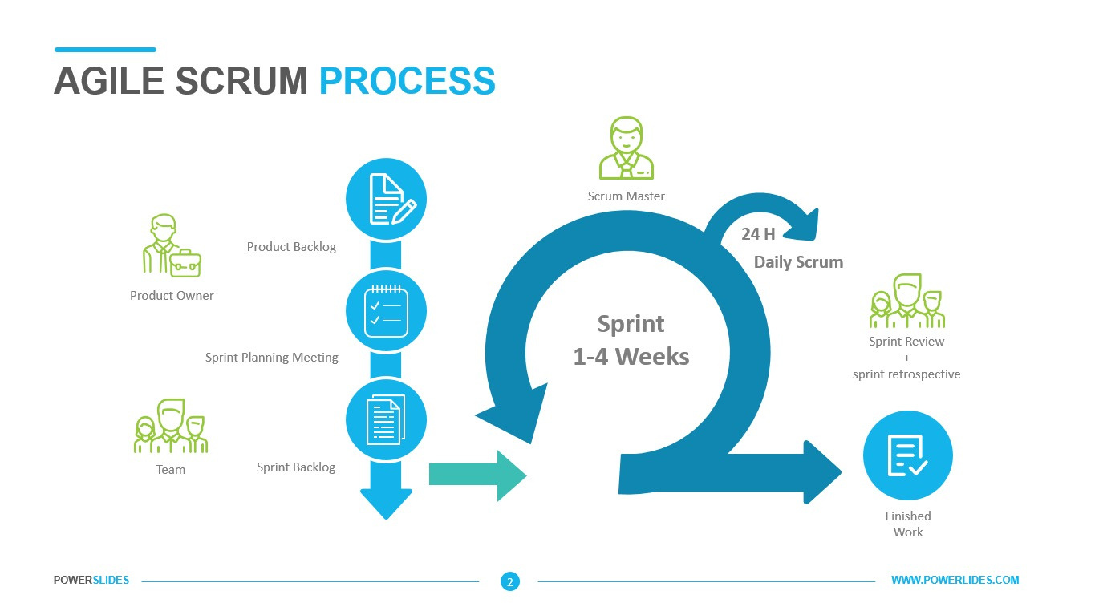
SCRUM Model

Slide 5
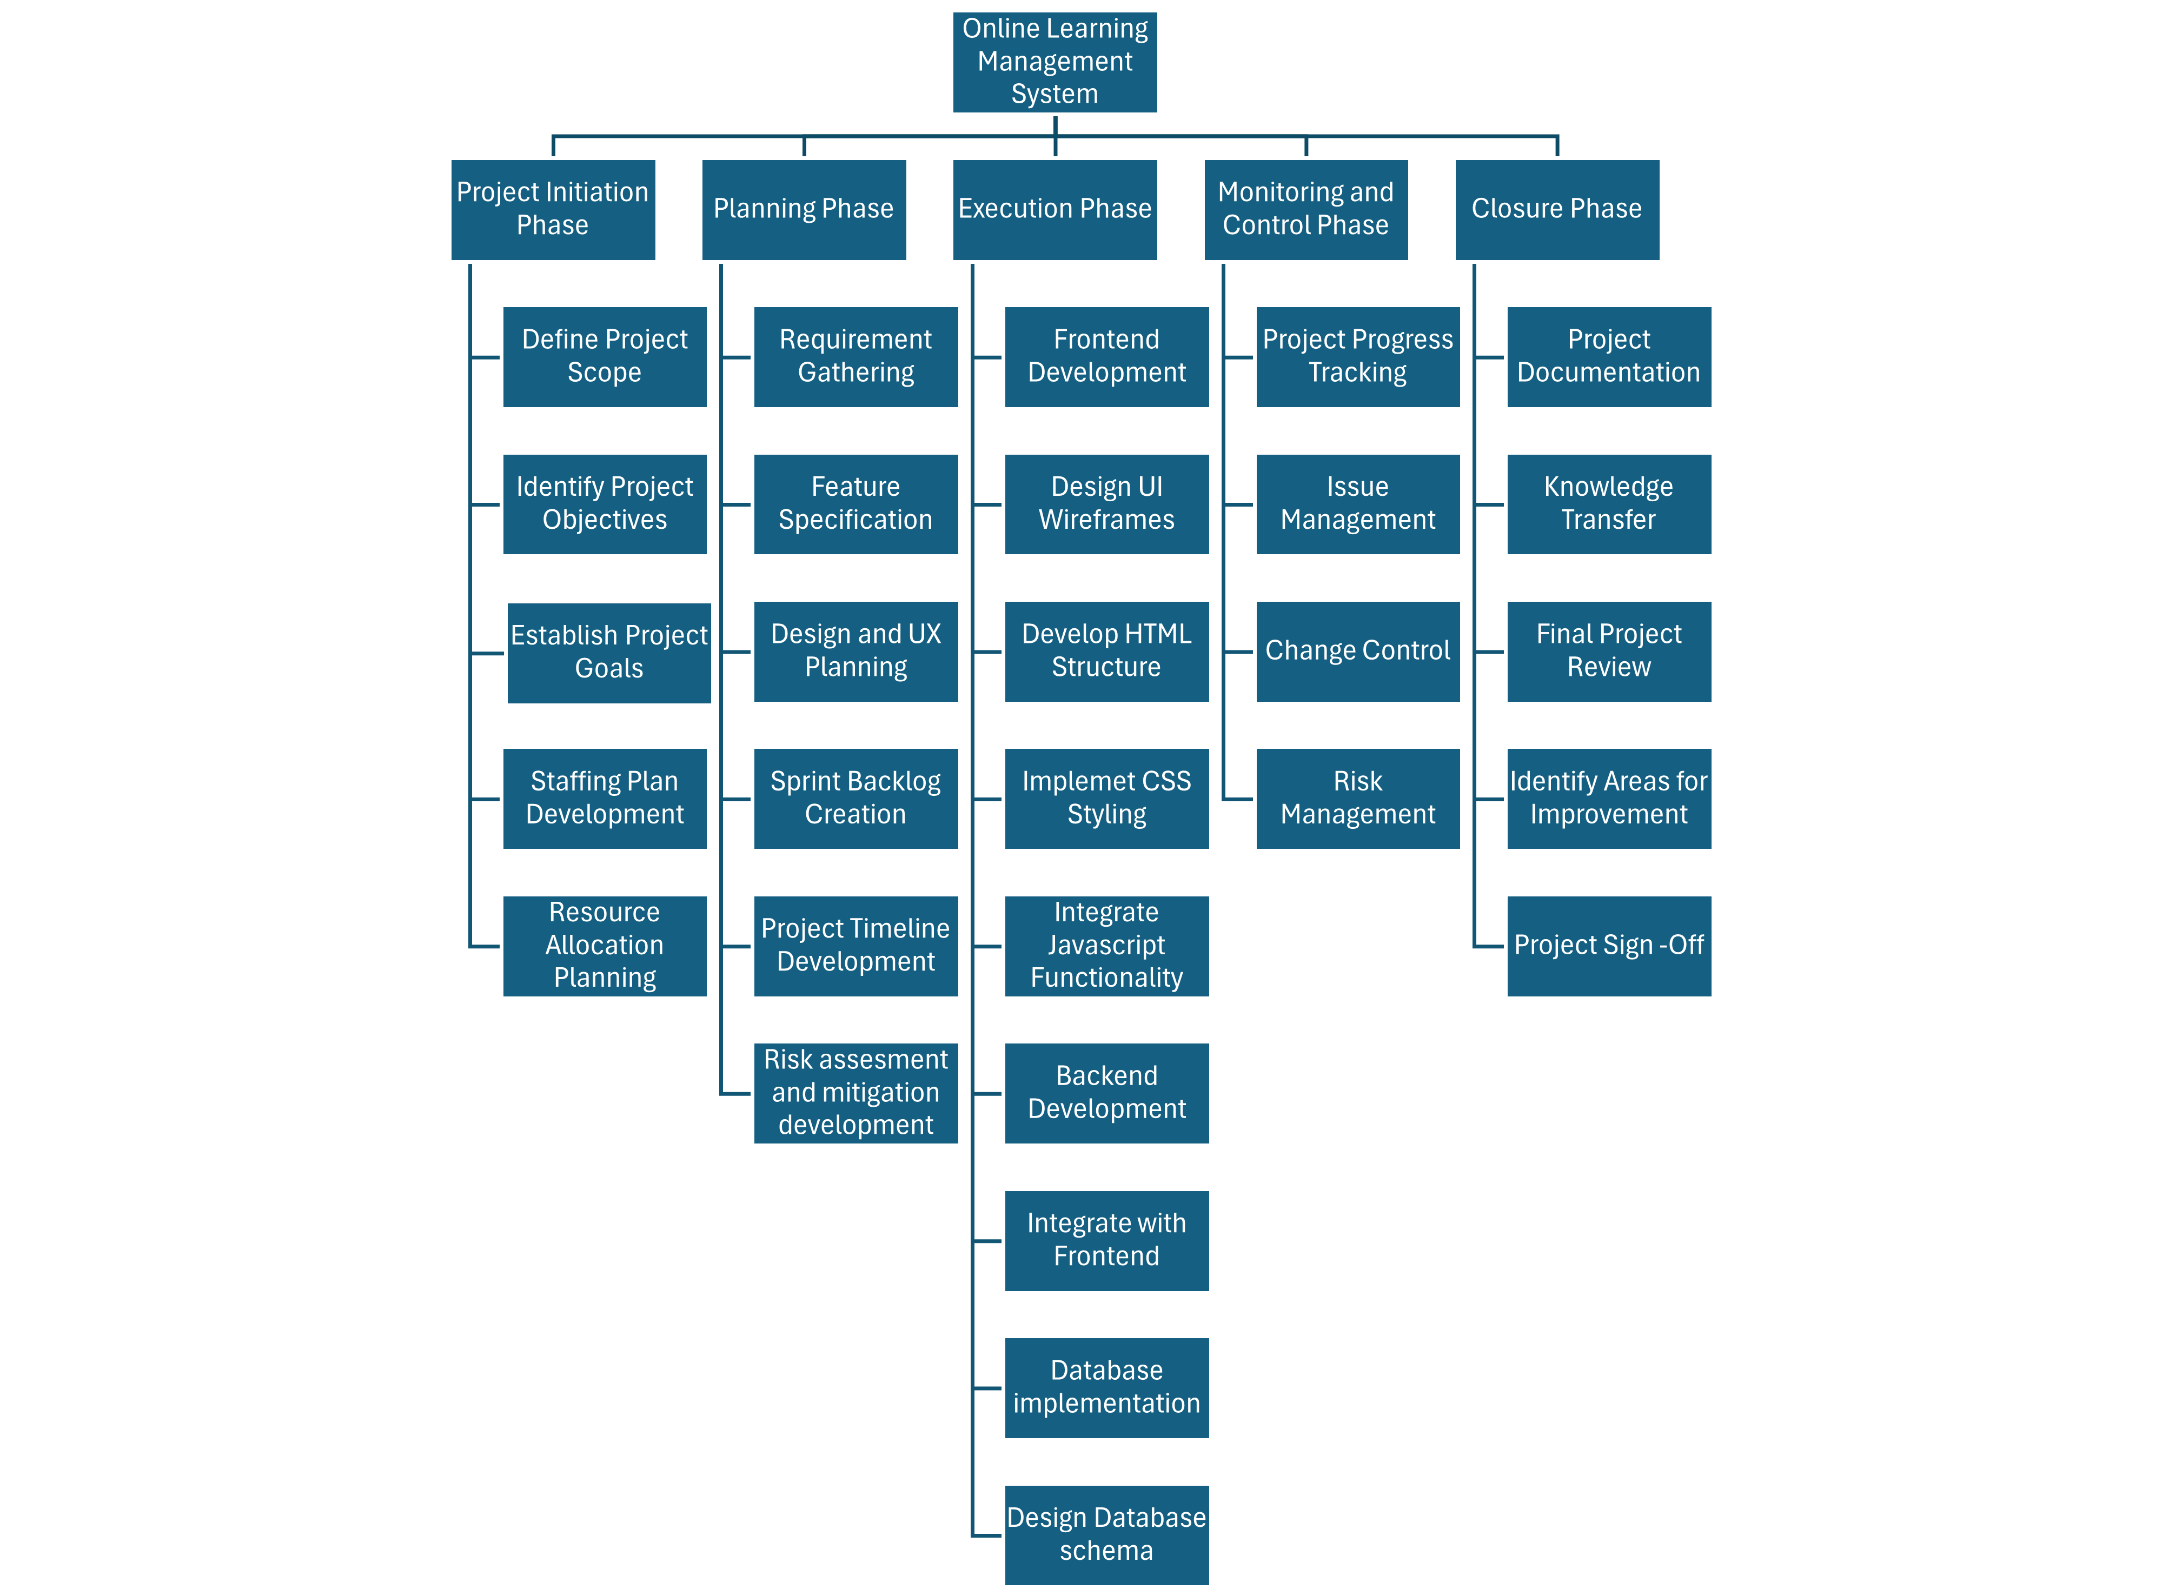
WBS

Slide 6
Tools and Framework
Tech Stack
HTML
CSS
JavaScript
Framework
Node JS
Express JS
Software
Visual Studio Code
Smart Sheet (for Gantt chart)
Lucid Chart(ER Diagram)
Jira
Firebase
MS Excel

Slide 7
Resource Allocation
Jaydeep Mojidra - Frontend Development (HTML, CSS, JS)
Pranjal Kamboj - Database (Firebase)
Samyak Jain - Backend Development (Node.js, JS) and REST API
Dhruv Shah - Frontend Development (HTML, CSS, JS)

Slide 8
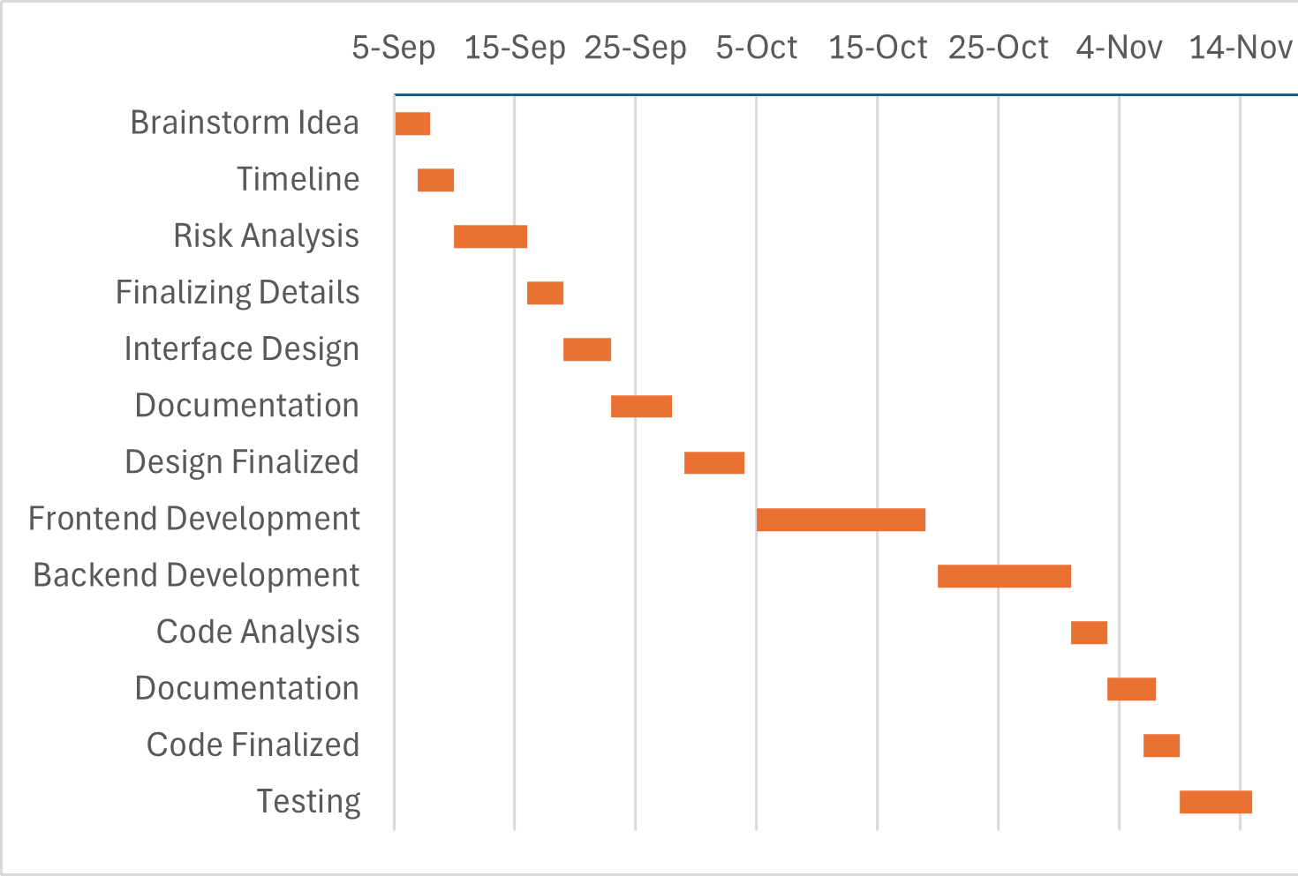
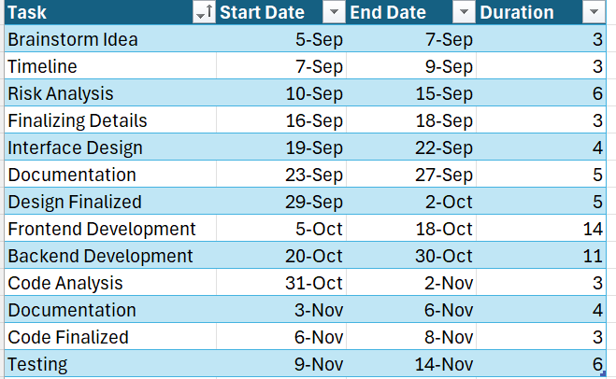
Gantt Chart

Slide 9
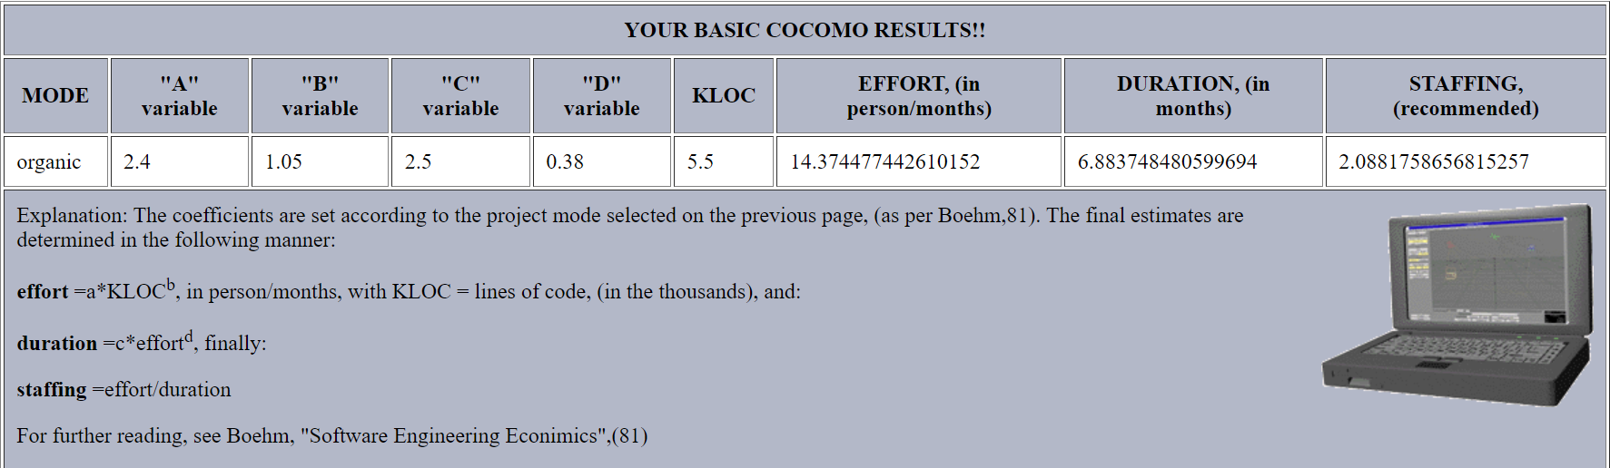
Cost Estimation

Slide 10
Function Point Estimation
• External Inputs (EI): Forms, buttons, or any input from users (e.g., login forms)
• External Outputs (EO): Reports, notifications, data shown to users.
• User Inquiries (EQ): Search functionality, data retrieval.
• Internal Logical Files (ILF): Internal databases or tables (courses, students).
• External Interface Files (EIF): External systems like external grading systems
For our project:
• EI: 5 (login, course creation, assignment submission, etc.)
• EO: 5 (grades, announcements, etc.)
• EQ: 3 (search courses, view grades)
• ILF: 3 (student, course, and assignment data)
• EIF: 5 (external APIs or external reports)
So, we get total 90 weighted measures and 0.65 factor so we get 59 Function points

Slide 11
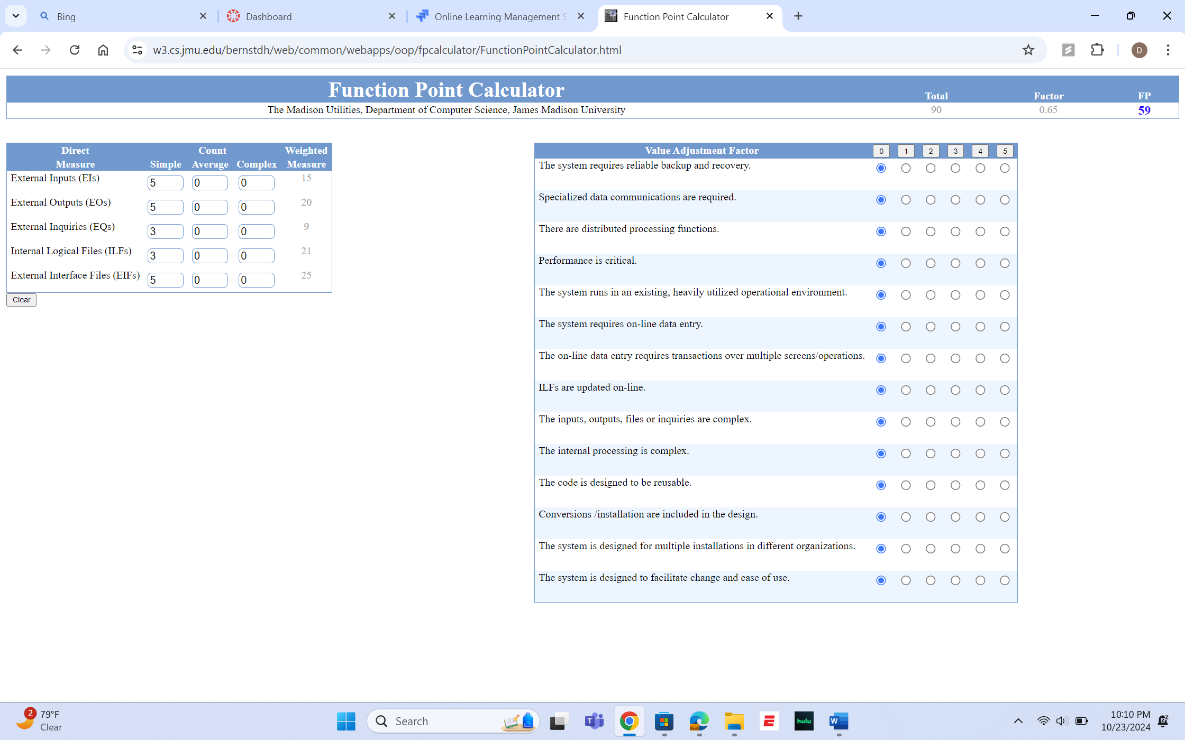

Slide 12
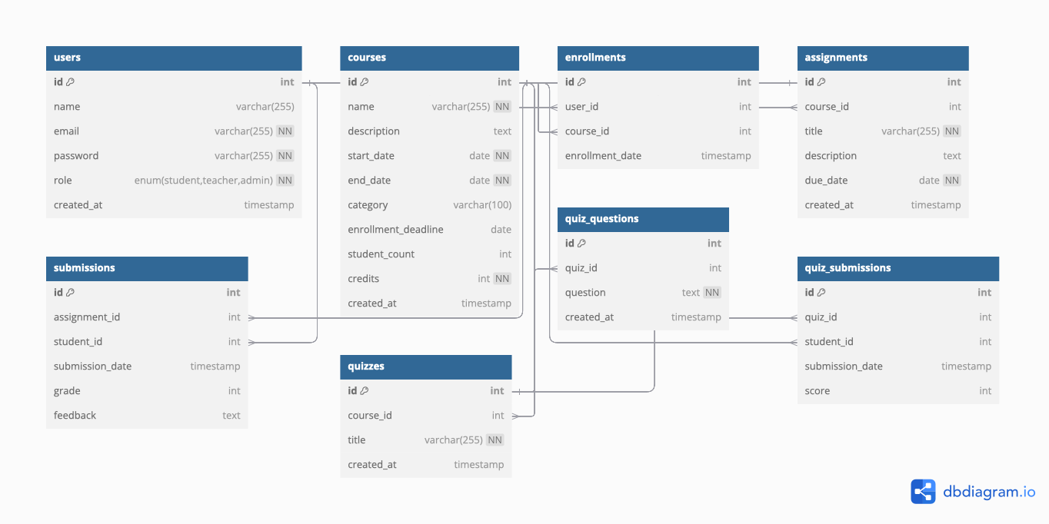
ER Diagram

Slide 13
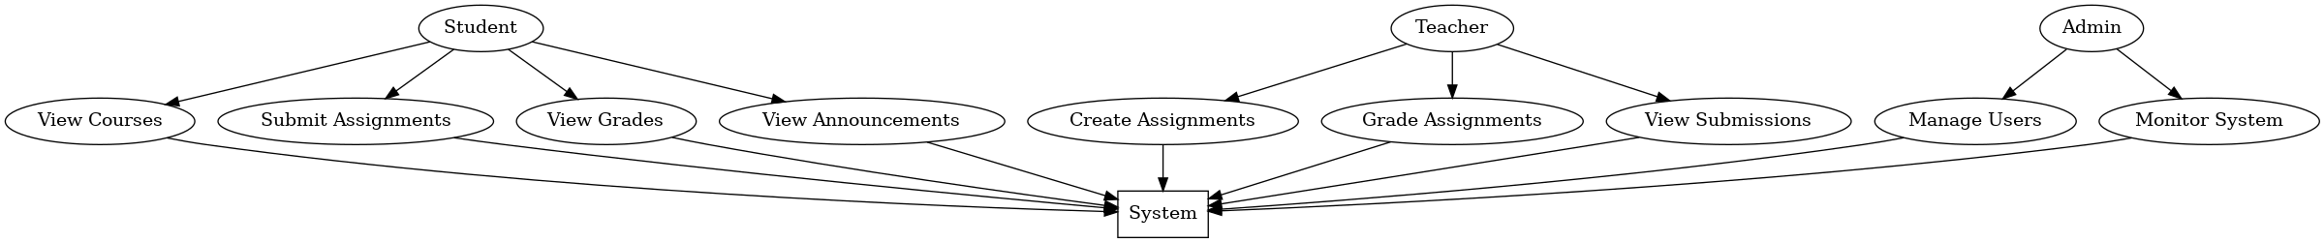
UML Diagram

Slide 14
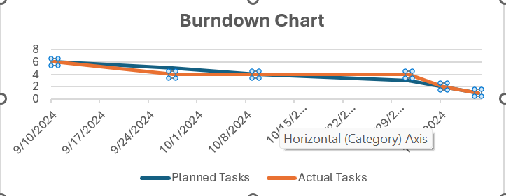
Burndown Chart

Slide 15
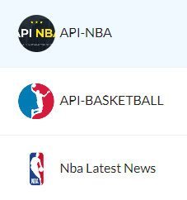
APIs Used
API NBA
Standings
API – BASKETBALL
Matches
NBA Latest News
News
GitHub Basketball API
Stats

Slide 16
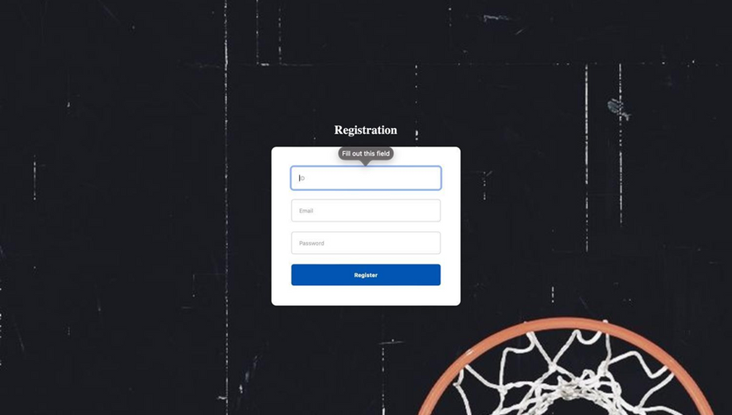
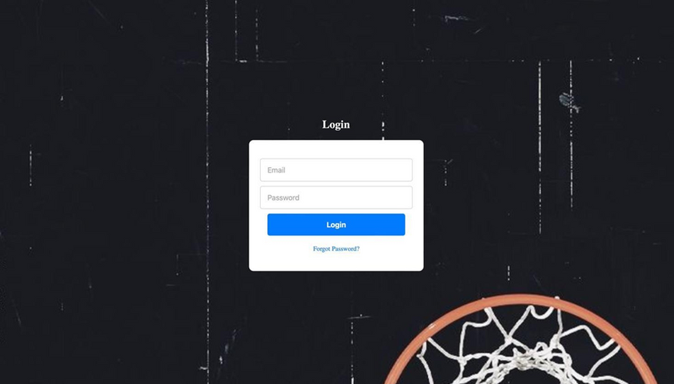
UI Snaps

Slide 17
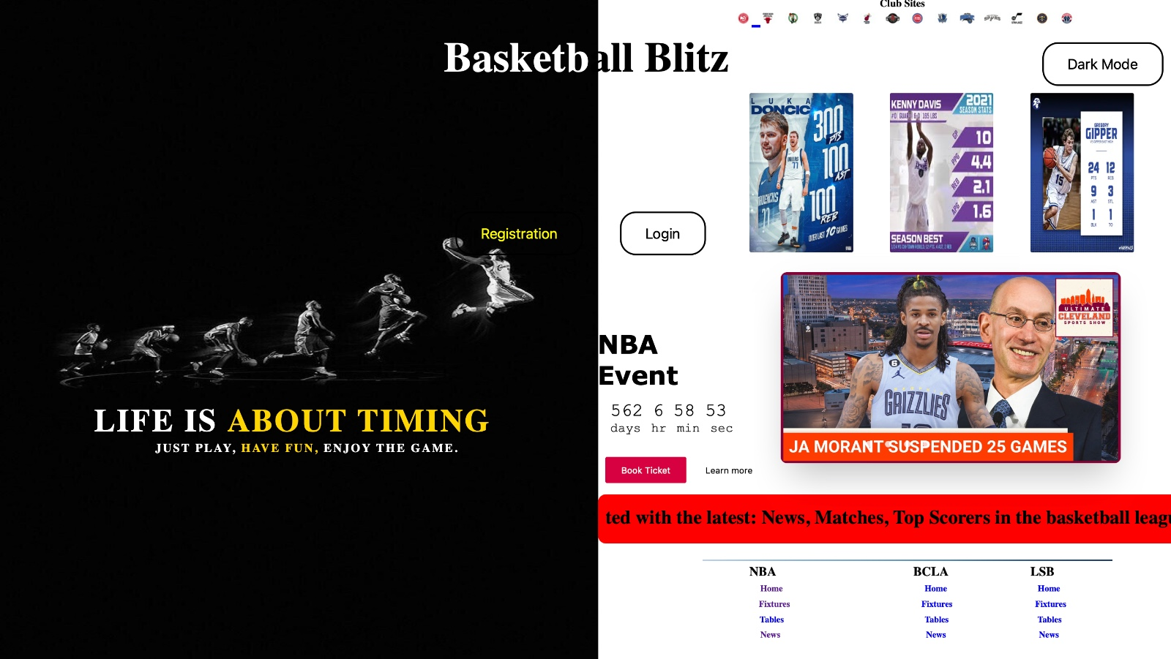
UI Snaps

Slide 18
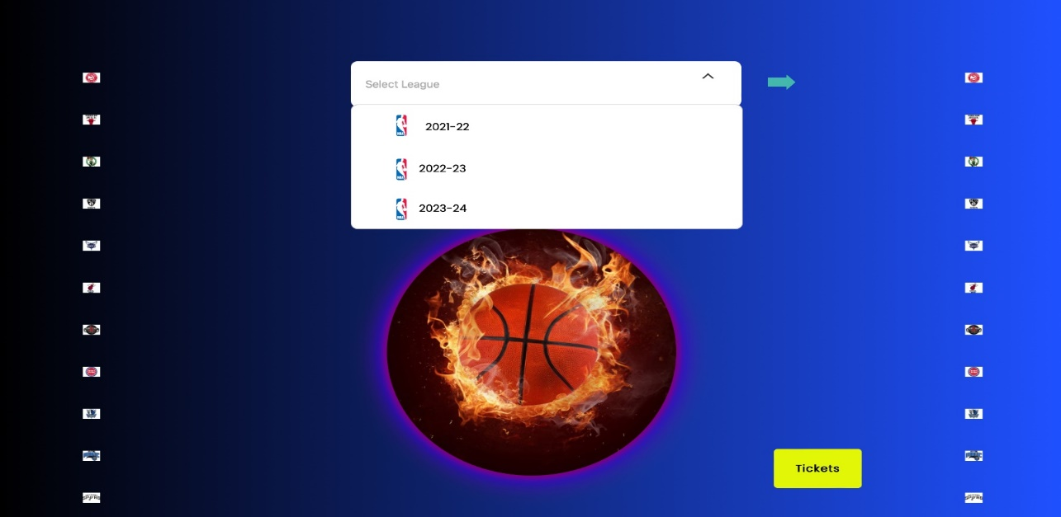
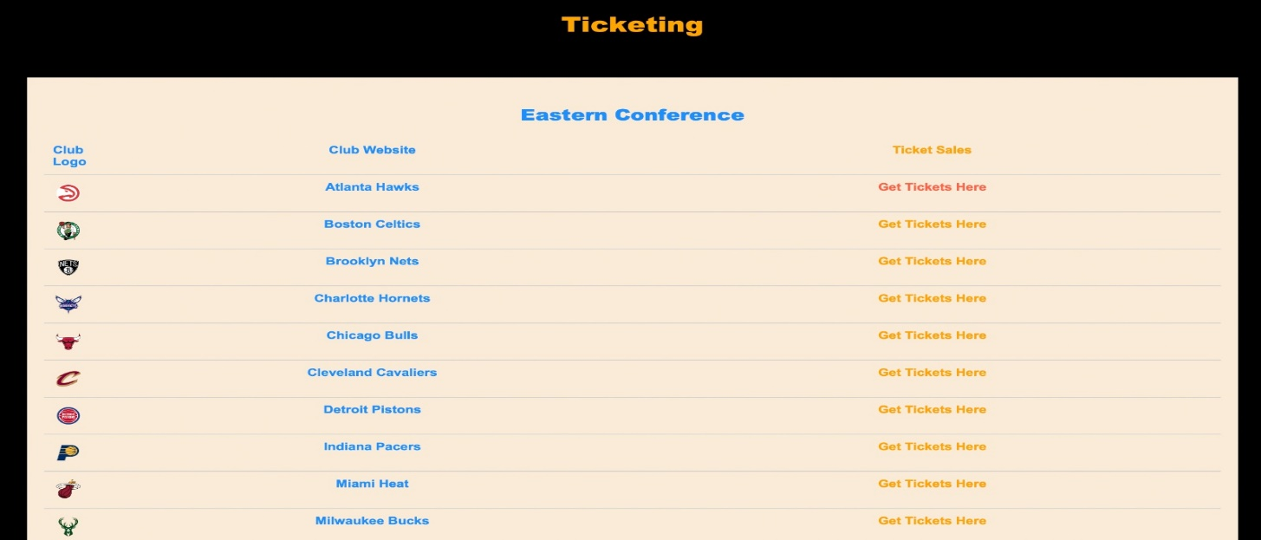
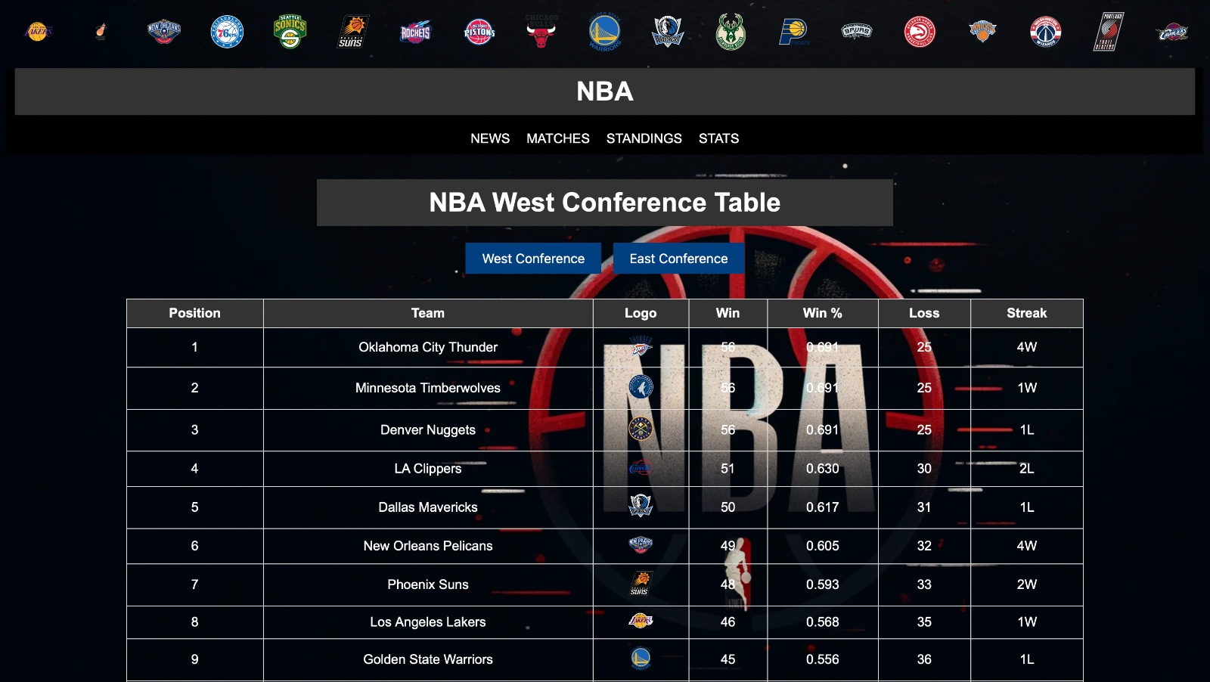
UI Snaps

Slide 19
Unit Testing Results
Test Case No. | Test Cases | Expected Results | Actual Results | Status
1 | Light/Dark Mode | Interface changes color scheme based on selected mode | Interface switches between light and dark mode successfully without any visual glitches | Pass
2 | Register | New user should be able to register an account | User fills out registration form and can successfully log in afterward | Pass
3 | Login | User should be able to log in with correct credentials | User successfully logs in with valid credentials | Pass
4 | Home Page | Upon successful login, user should be redirected to the home page displaying relevant information and options. | User logs in and is directed to the home page where relevant content and navigation options are displayed correctly. | Pass
5 | Select League | User should be able to select a sports league from available options. | User navigates to the league selection page, chooses a league, and the selection is reflected accurately. | Pass
6 | Purchase Tickets | User should be able to select tickets for a game/event | User selects desired game/event and purchases its tickets | Pass

Slide 20
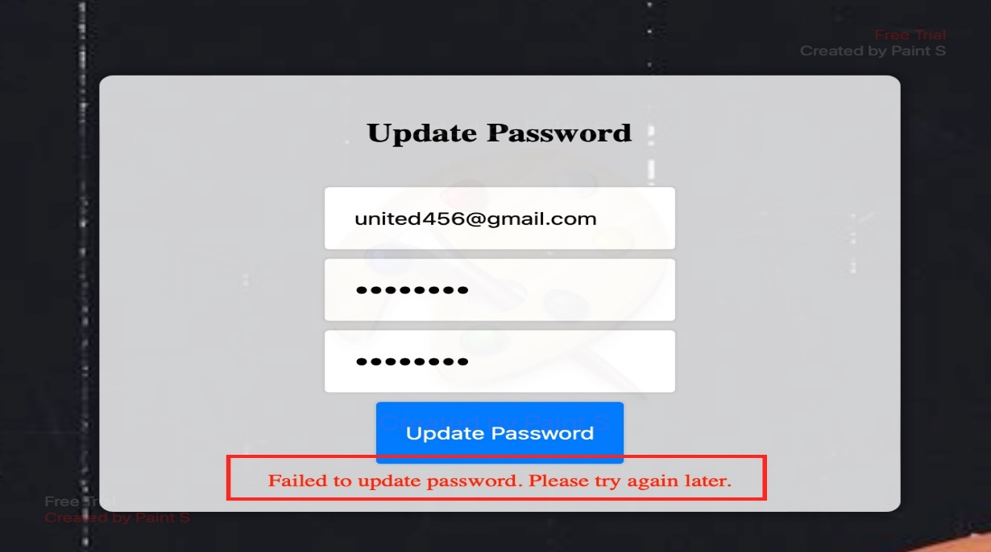
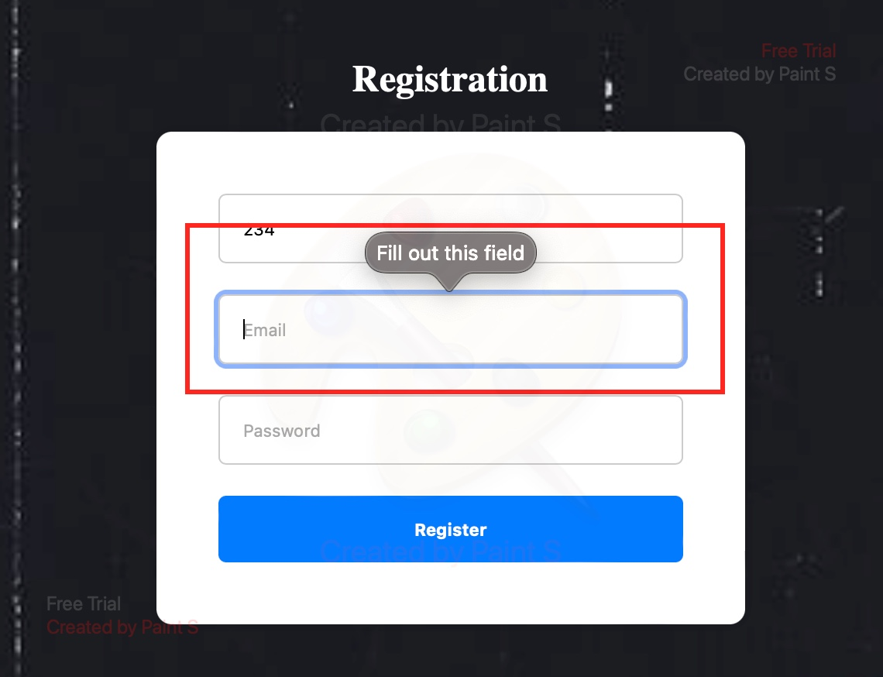
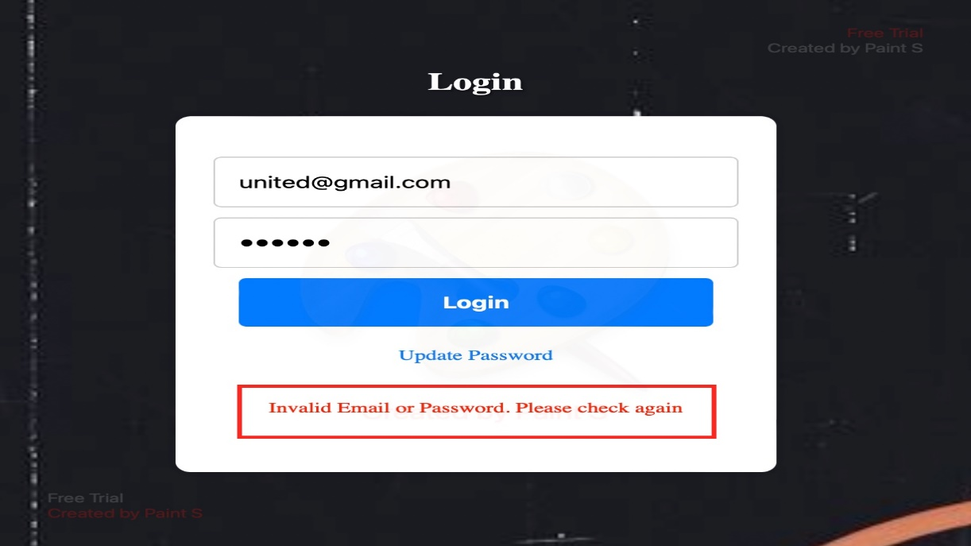
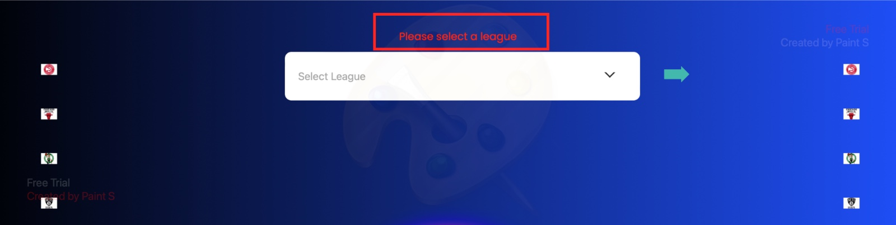
Unit Testing Snaps

Slide 21
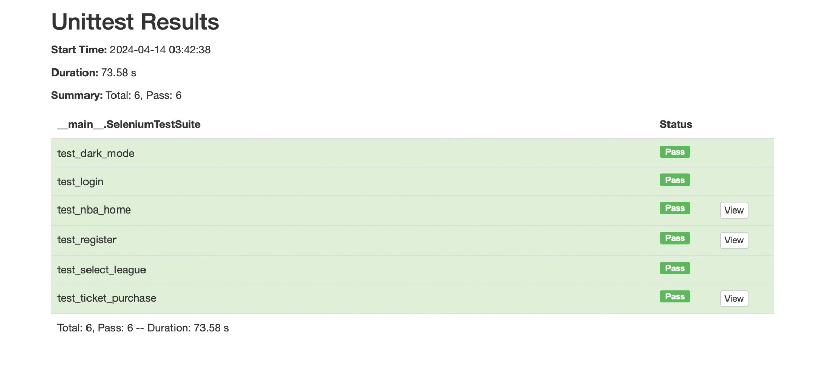
Testing Results

Slide 22
Risk Factors
Challenges in Development- Such as coding delays, integration complications,
team members experiencing illness, or implementation difficulties.
Compatibility Problems- Including issues with various browsers, devices, or
operating systems being incompatible.
Performance Considerations- Such as sluggish loading speeds.
Website Inaccessibility Due to Server Issues- Technical glitches or server malfunctions resulting in downtime.
Delayed Responsiveness- Performance lagging due to server overload or
inefficient coding.

Slide 23
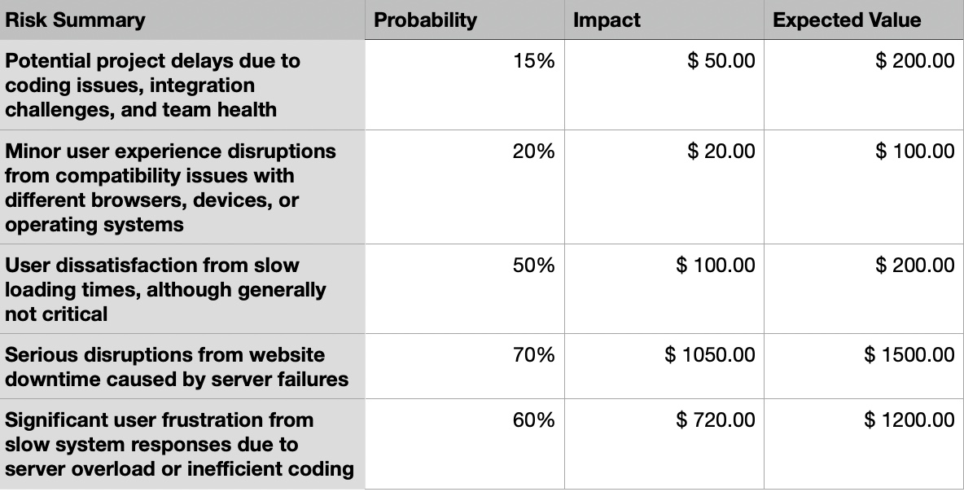
Risk Assessment

Slide 24
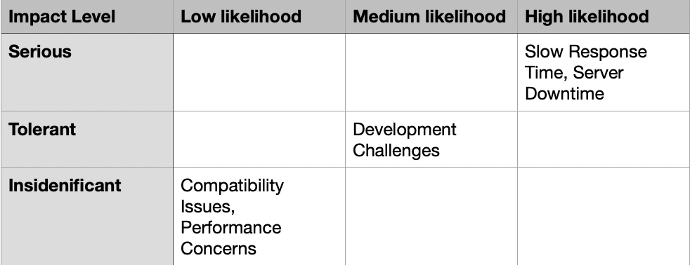
Risk Mitigation Plan

Slide 25
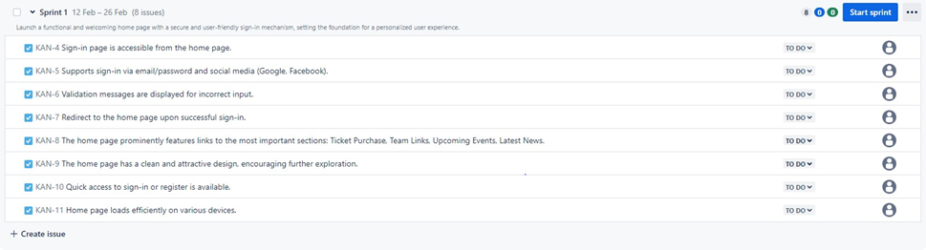
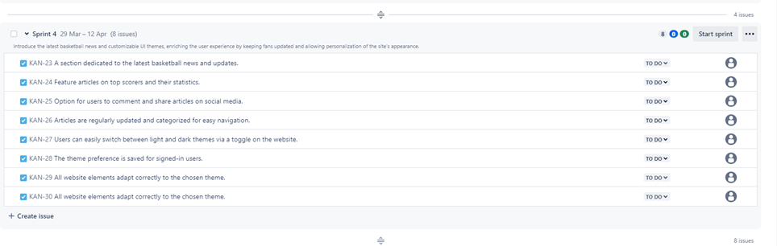
Management Tools

Slide 26
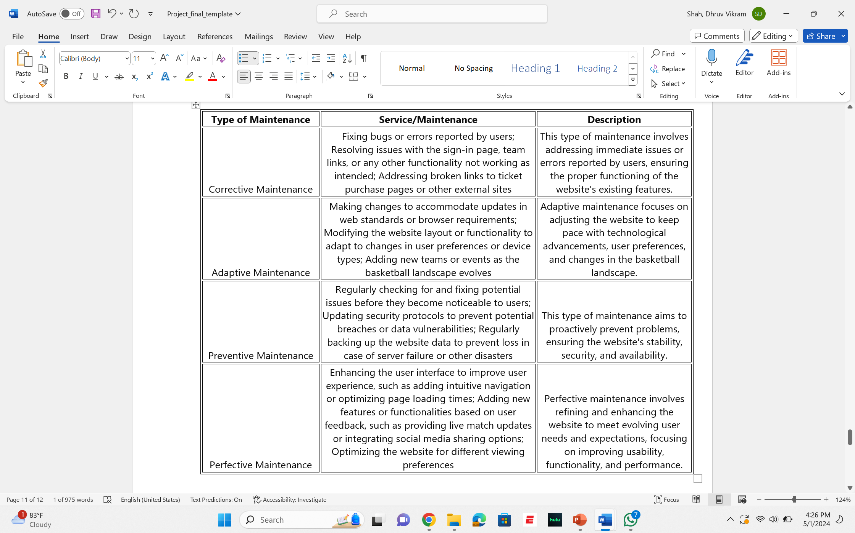
Maintenance

Slide 27
Future Scope
Interactive Fan Community: We can integrate a forum or community section where fans can discuss games, players, and related topics. This can foster engagement and loyalty among users.
Fantasy Basketball League: We can implement a fantasy basketball league where users can create their own teams, compete against each other, and earn points based on the player’s performances.
Merchandise Store: We can offer an online store where fans can purchase team merchandise, jerseys, memorabilia, and other related items. This can be a significant revenue stream.
Mobile App Integration: We can develop a companion mobile app for our website, allowing users to access all features on their smartphones and tablets for convenience on the go.
Social Media Integration: We can enable users to share content from our website directly to their social media accounts, increasing visibility and attracting more visitors.
Player Profiles and Interviews: We can provide in-depth profiles of players, including their career statistics, achievements, and personal backgrounds and provide interviews with players to give fans insights into their lives on and off the court.

Slide 28
References
W3schools
Stack Overflow
NBAOfficial website
Google scoreboard
API Documentation

Slide 29
THANK YOU!

